Slide 1
BMI AND BODY CONSITUENTS BASED FOOD SUGGESTIONS
BY:
CYBER WARRIORS

Slide 2
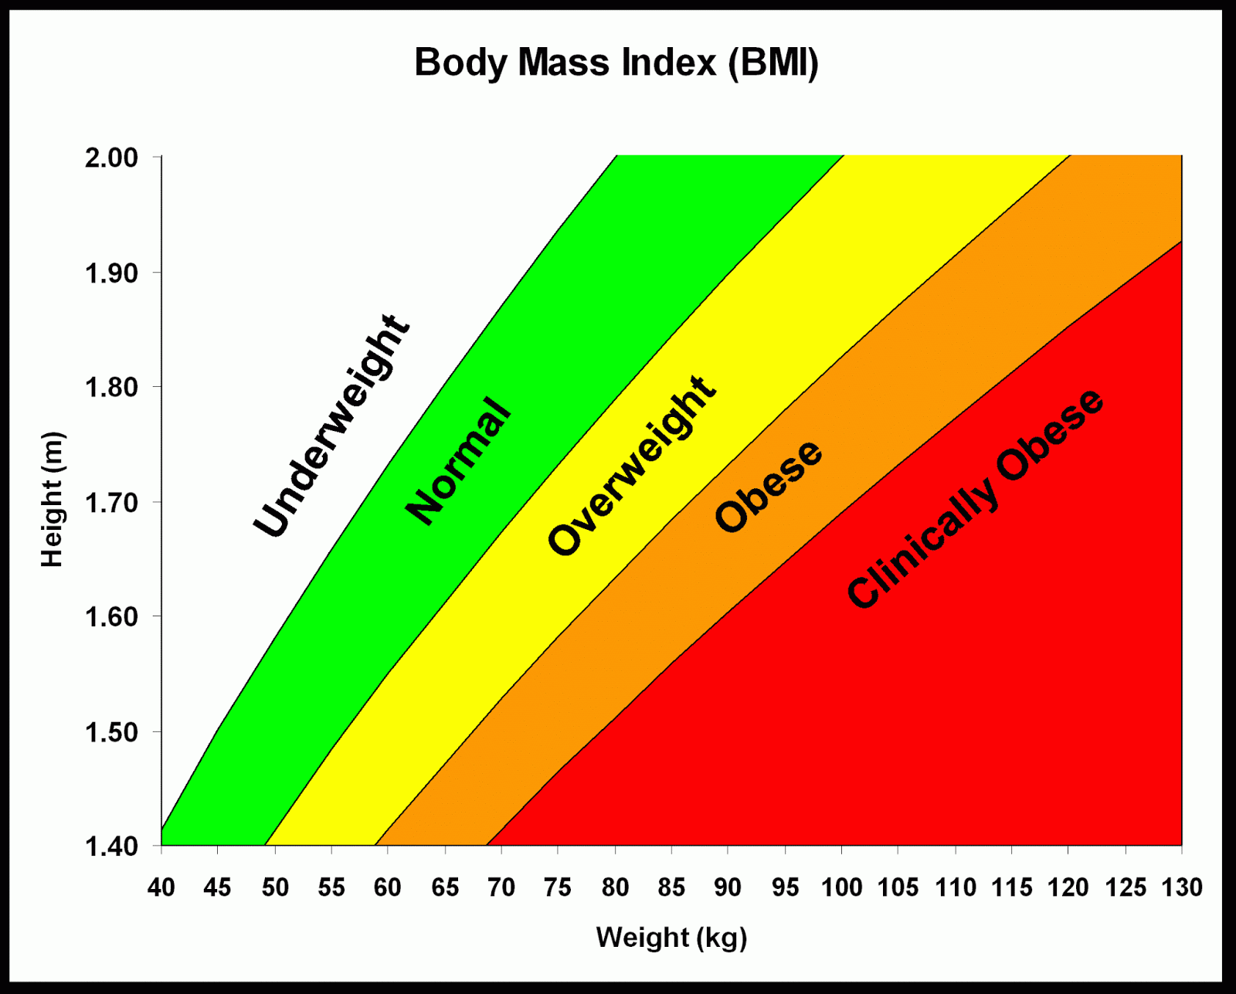
BODY MASS INDEX
BMI is an inexpensive and easy screening method for weight category—underweight, healthy weight, overweight, and obesity.
Body mass index (BMI) is a person’s weight in kilograms divided by the square of height in meters.
It is more of an indicator than a direct measurements of a total person’s body fat.
As the BMI increases, so does the person’s total body fat increases.

Slide 3
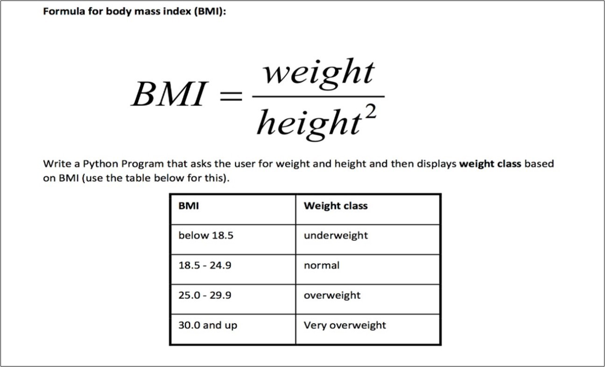
FORMULA
Formula: weight (kg) / [height (m)]²
Calculation: [weight (kg) / height (cm) / height (cm)] x 10,000

Slide 4
WHO CLASSIFICATION -
WIEGHT STATUS | BODY MASS INDEX kg/m2
Under Weight | <18.5
Normal Range | 18.5 – 25.9
Over Range | 25.0 – 29.9
Obese | > 30
Obese Class-1 | 30.0 – 34.9
Obese Class-2 | 35.0 – 39.9
Obese Class-3 | > 40

Slide 5
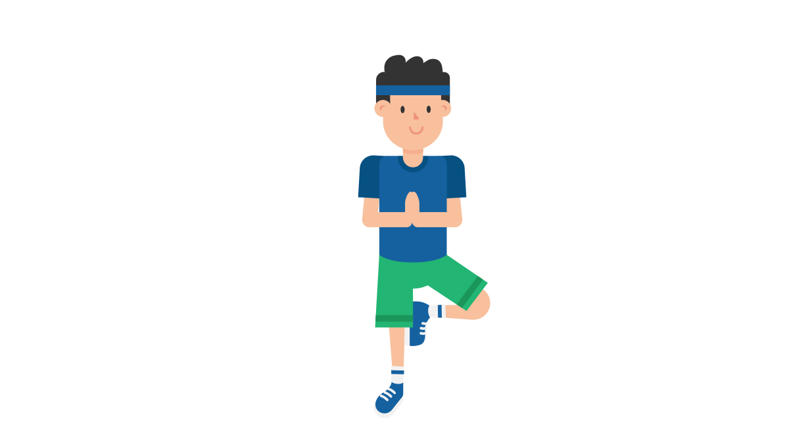

OVERWEIGHT AND OBESITY - MANAGEMENT
Lifestyle Change
Exercise to burn fat
Exercise for overweight and obesity
Yoga

Slide 6
Merits
demerits
BMI helps measure the obesity rate in people. Observing the changes in BMI values help the doctors evaluate the obesity levels in people over time.
When the BMI of a significant population is calculated, it helps researchers gather data that can be used to examine the obesity epidemic.
Knowing the BMI value of an individual, doctors can mitigate the health risks arising due to obesity.
Even when you have an average weight, based on the BMI value, you might fall under the overweight category.
BMI does not distinguish between the type of fat one carries - whether it is subcutaneous or visceral fat.

Slide 7
OUR TEAM -
Sribalajy N S [SRIBALAJY N S]
Seenivasan A [SEENIVASAN A]
Sriman Narayanan M [Sriman Narayan]
Rakesh Velavaluri [Rakesh Velavaluri]
Yukesh Kumar S [Yukesh Kumar]

Slide 8
THANK YOU !!

